Slide 1

CSE3251
Computer Networks
Dr. Asif Zaman
Professor, CSE, RU

Slide 2
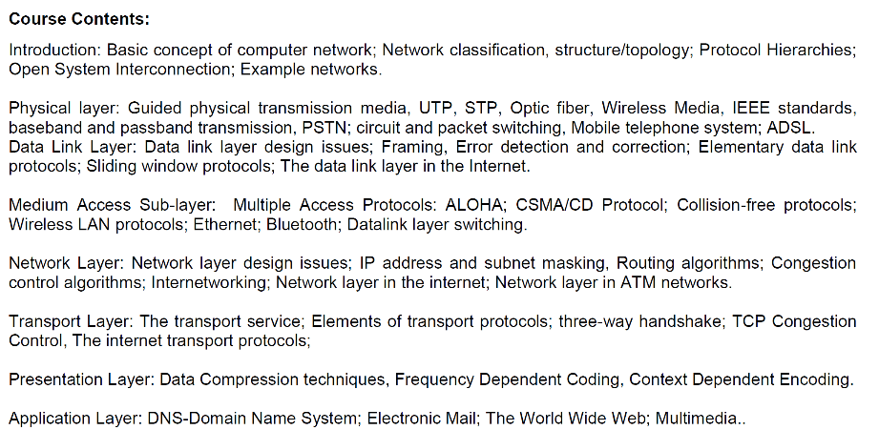

Slide 3
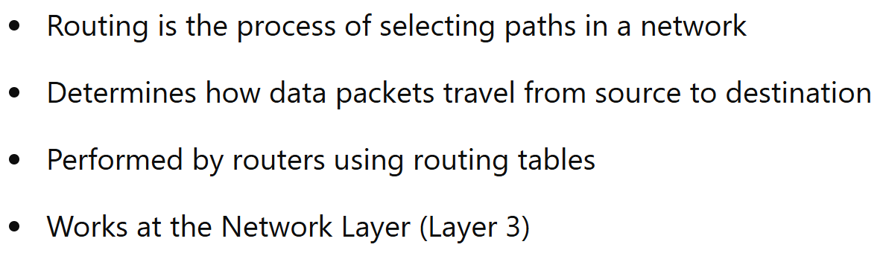
What Is Network Routing?

Slide 4
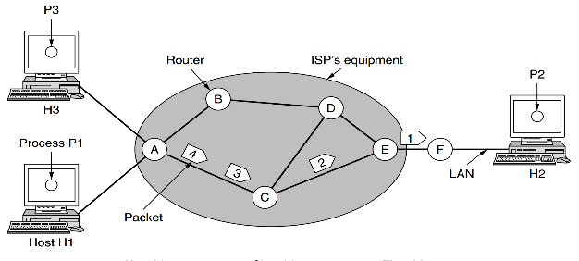
What Is Network Routing?
100 Hosts
150 Hosts
100 Hosts

Slide 5
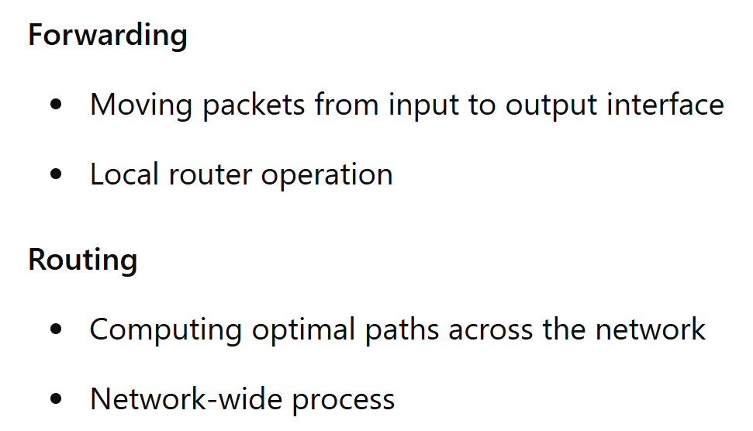
Routing vs Forwarding

Slide 6
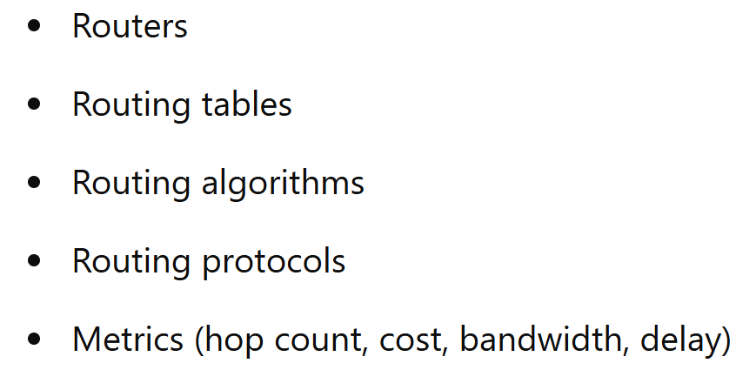
Components of Routing

Slide 7
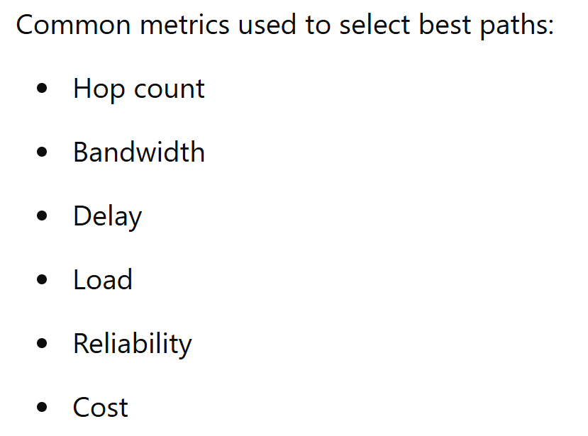
Routing Metrics

Slide 8
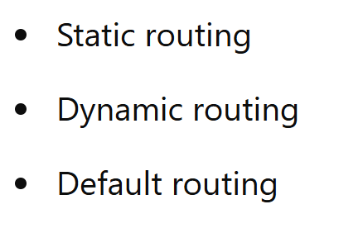
Types of Routing

Slide 9
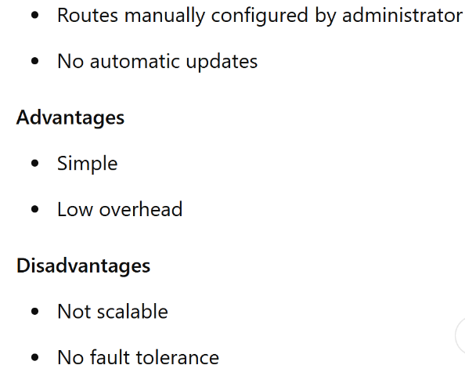
Static Routing

Slide 10
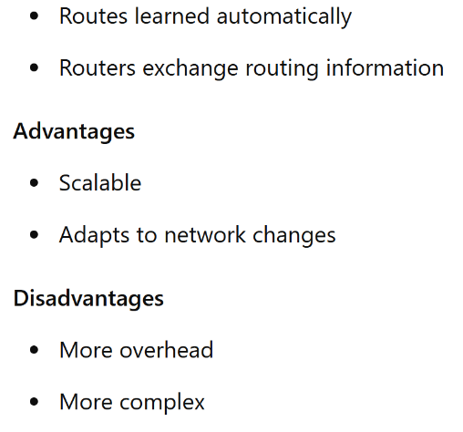
Dynamic Routing

Slide 11
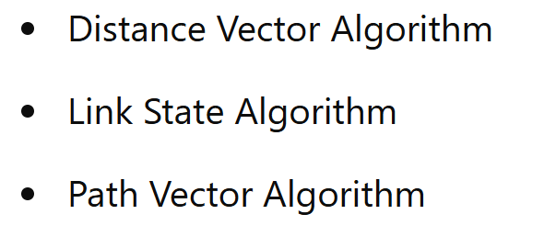
Routing Algorithm

Slide 12
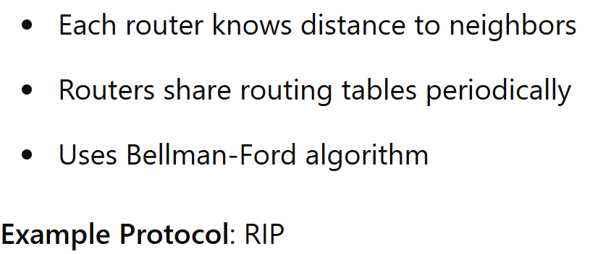
Distance Vector Routing
Routing Information Protocol

Slide 13
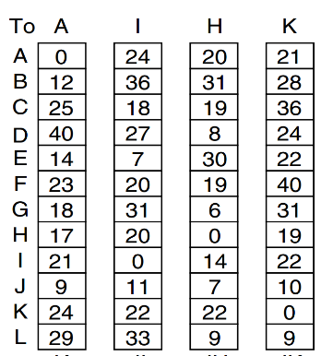
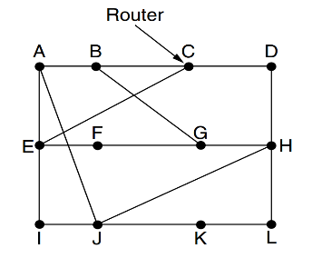
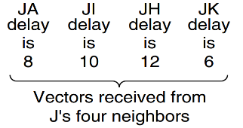




$$8+18=26$$
$$10+31=41$$
$$12+06=18$$
$$06+31=37$$
G: Send via A -18ms

Slide 14
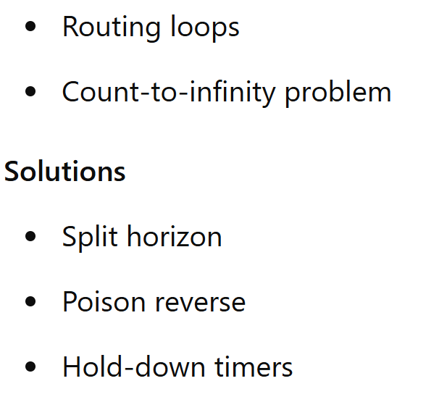
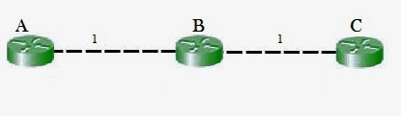
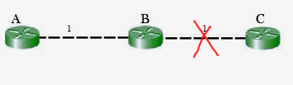
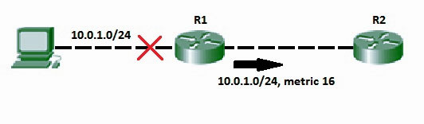
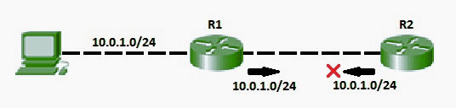
Problems in Distance Vector Routing
https://www.geeksforgeeks.org/computer-networks/route-poisoning-and-count-to-infinity-problem-in-routing/

Slide 15
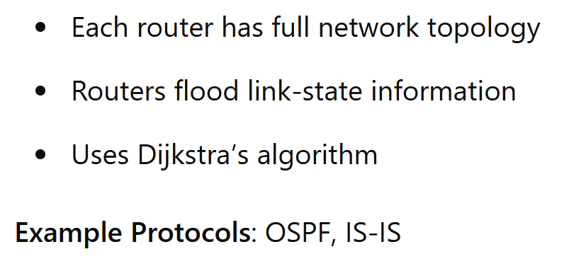
Link State Routing

Slide 16
Flooding
When a routing algorithm is implemented, each router must make decisions based on local knowledge, not the complete picture of the network.
A simple local technique is flooding, in which every incoming packet is sent out on every outgoing line except the one it arrived
D
S

Slide 17
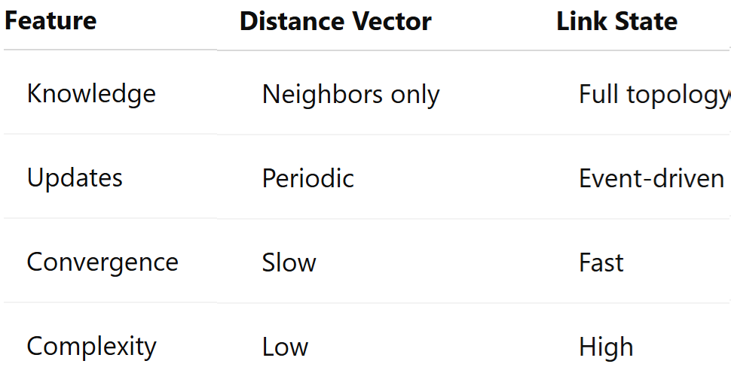
Distance Vector vs Link State

Slide 18
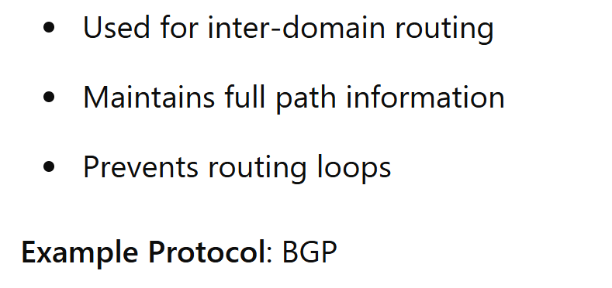
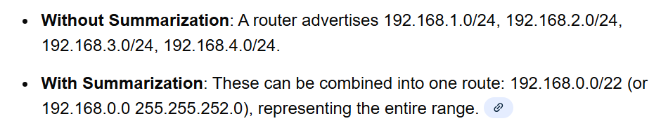
Path Vector Routing

Slide 19
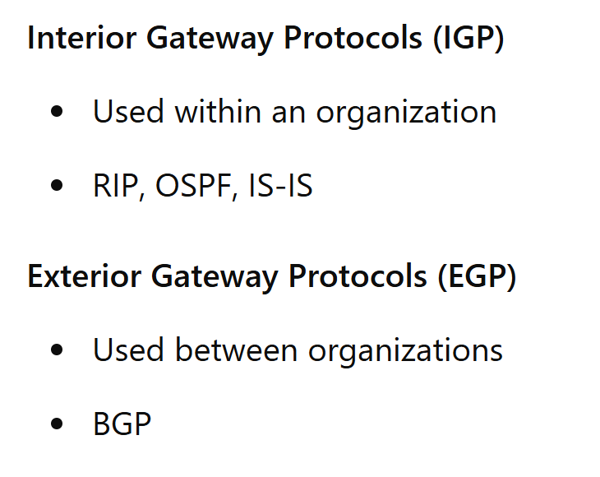
Interior vs Exterior Routing

Slide 20
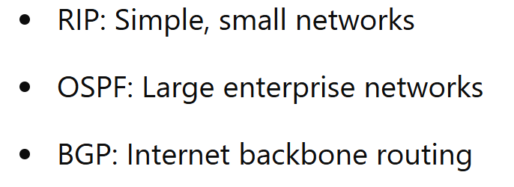
Real-World Routing Protocols

Slide 21
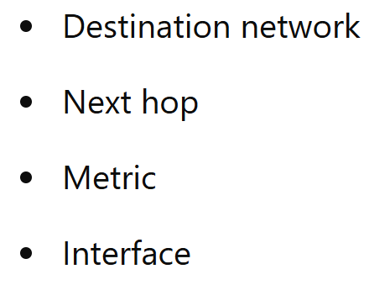
Routing Table Structure

Slide 22
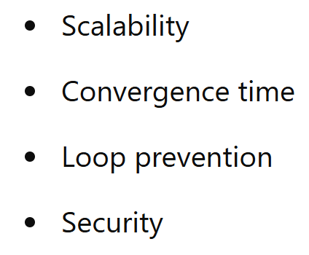
Challenges in Routing

Slide 23
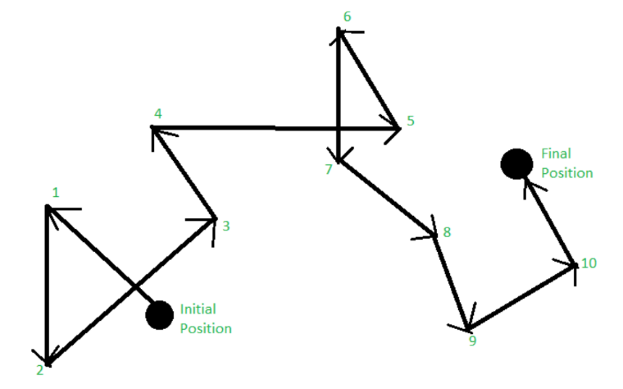
Random Walk

Slide 24
Optimality Principle
It states that if router J is on the optimal path from router I to router K then the optimal path from J to K also falls along the same route

Slide 25
ARP and RARP
Address Resolution Protocol (32bit IP to 48 bit MAC)
Reverse Address Resolution Protocol (48 bit MAC to 32 bit IP)

